Slide 1
Object Oriented Programming(Java) Lecture-07-08

Slide 2
Content
Java Inheritance.
Example of Inheritance.
Access Modifier.
Java Method overriding.
Super Keyword.
Types of Inheritance.
Why use inheritance?

Slide 3
Java Inheritance :
Inheritance is one of the key features of OOP (Object-oriented Programming) that allows us to define a new class from an existing class.
In Java, we use the extends keyword to inherit from a class.

Slide 4
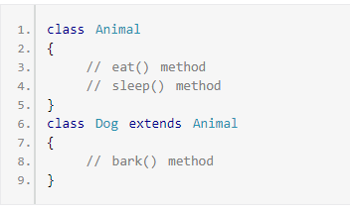
Example :Java Inheritance

Slide 5
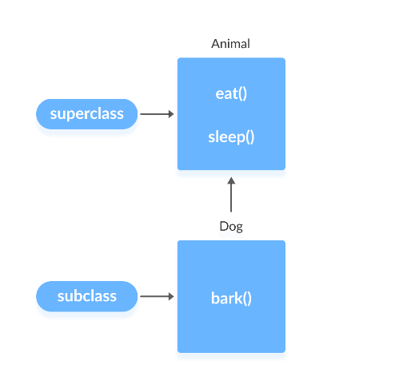
Example :Java Inheritance(Contd.)

Slide 6
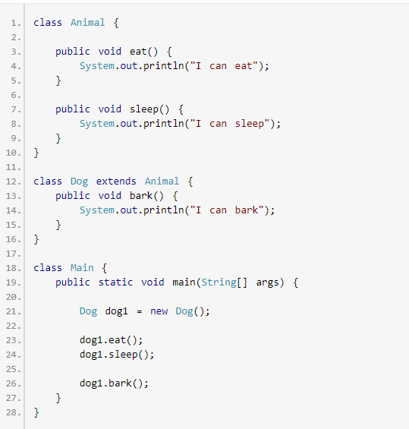
Example1 :Java Inheritance

Slide 7
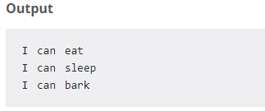
Example1 :Java Inheritance(Contd.)

Slide 8
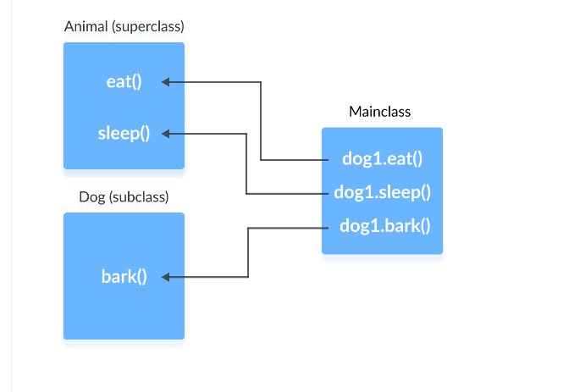
Example1 :Java Inheritance(Contd.)

Slide 9
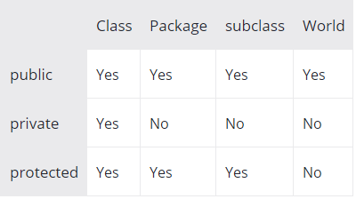
Access Modifier :

Slide 10
Java Method overriding :
What happens if the same method is defined in both the superclass and subclass?

Slide 11
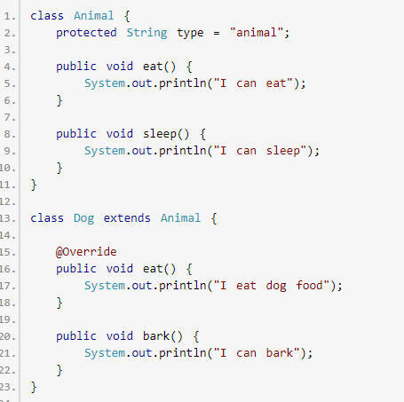
Java Method overriding(Contd.):

Slide 12
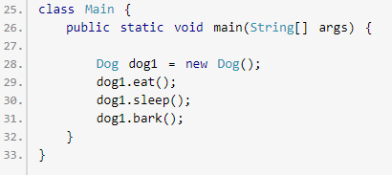
Java Method overriding(Contd.):

Slide 13
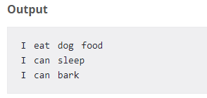
Java Method overriding(Contd.):

Slide 14
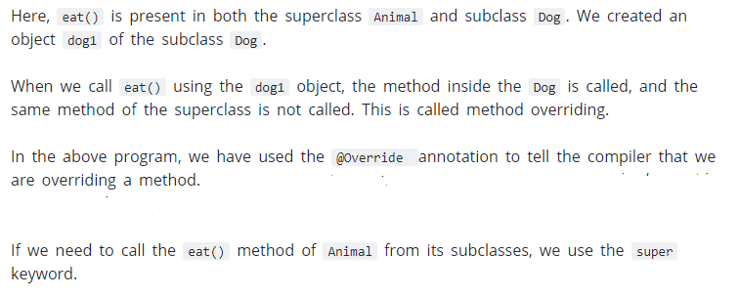
Java Method overriding(Contd.):

Slide 15
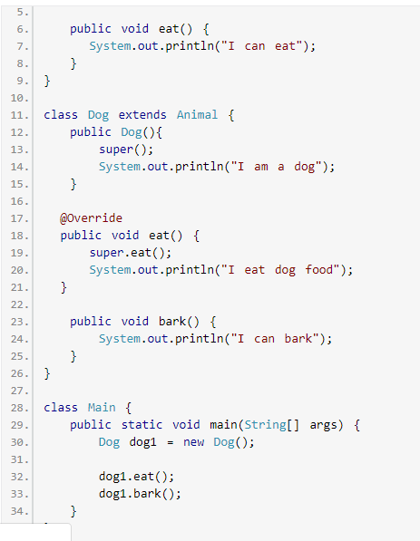
Super Keyword :

Slide 16
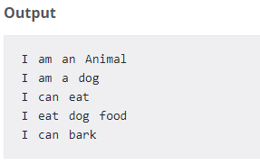
Super Keyword(Contd.) :

Slide 17
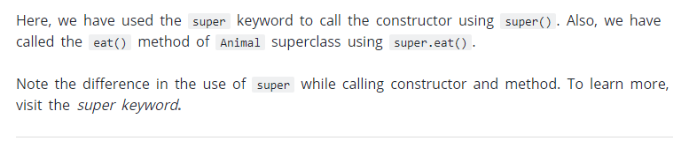
Super Keyword(Contd.) :

Slide 18
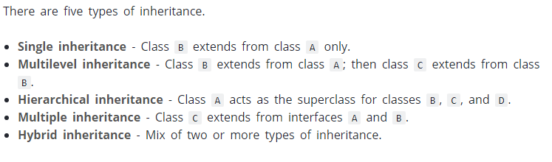
Types of inheritance :

Slide 19
Why use inheritance?
The most important use is the reusability of code. The code that is present in the parent class doesn’t need to be written again in the child class.
To achieve runtime polymorphism through method overriding.

Slide 20
Thanks

